Slide 1

Large Language Models for
Hardware Design: A Retrospective
Jason Blocklove, Luca Collini, Andre Nakkab,
Ramesh Karri, Siddharth Garg
29 May, 2025

Slide 2


Follow along!

Slide 3
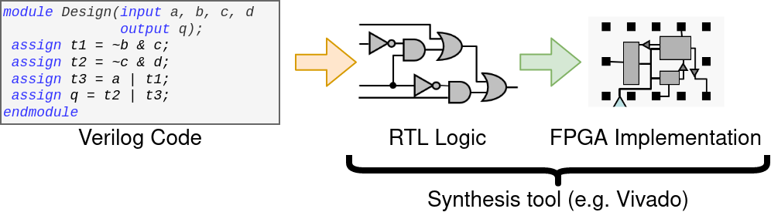
The Verilog HDL
Verilog used to design digital systems
Implementation

Slide 4
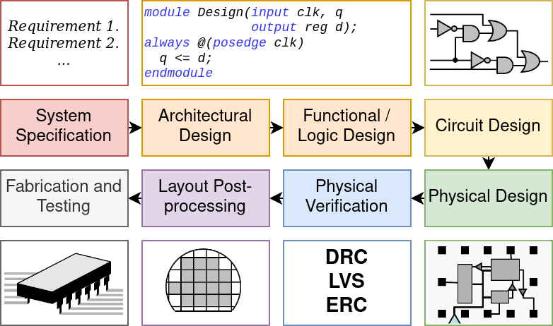
The Digital Design pipeline
Specification → Implementation is hard

Slide 5
LLM for Hardware Design Timeline
…
2017 - Attention is All You Need
Introduced transformers
Precursor to LLM boom
A. Vaswani et al., “Attention Is All You Need,” arXiv, Jun. 12, 2017. https://arxiv.org/abs/1706.03762

Slide 6
LLMs for Hardware Design Timeline
2018 - GPT-1
OpenAI’s first GPT model
Finetuned for basic NLP
…
2017 - Attention is All You Need

Slide 7
LLMs for Hardware Design Timeline
2018 - GPT-1
…
2017 - Attention is All You Need
2018 - GPT-2
10x larger than GPT-1
Trained on “high-quality” websites

Slide 8
LLMs for Hardware Design Timeline
2020 - DAVE
First work aimed specifically at generating hardware
Finetuned GPT-2
2018 - GPT-1
…
2017 - Attention is All You Need
2018 - GPT-2
H. Pearce, B. Tan, and R. Karri, ‘DAVE: Deriving Automatically Verilog from English’, in Proceedings of the 2020 ACM/IEEE Workshop on Machine Learning for CAD, 2020, pp. 27–32.
Notes:
DAVE - Deriving Automatically Verilog from English (2020)
Finetuned GPT-2 over textbook problems
Was good with syntax, but had no “creativity” and wouldn’t create any new variables

Slide 9
LLMs for Hardware Design Timeline
2018 - GPT-1
2020 - DAVE
…
2017 - Attention is All You Need
2018 - GPT-2
2020 - GPT-3/Codex
100x larger than GPT-2
Codex was an offshoot finetuned for code

Slide 10
LLMs for Hardware Design Timeline
2022 - VeriGen
Finetuned series of models specifically for Verilog
2018 - GPT-1
2020 - DAVE
…
2017 - Attention is All You Need
2018 - GPT-2
2020 - GPT-3/Codex
S. Thakur et al., ‘Benchmarking Large Language Models for Automated Verilog RTL Code Generation’, arXiv [cs.PL]. 2022.

Slide 11
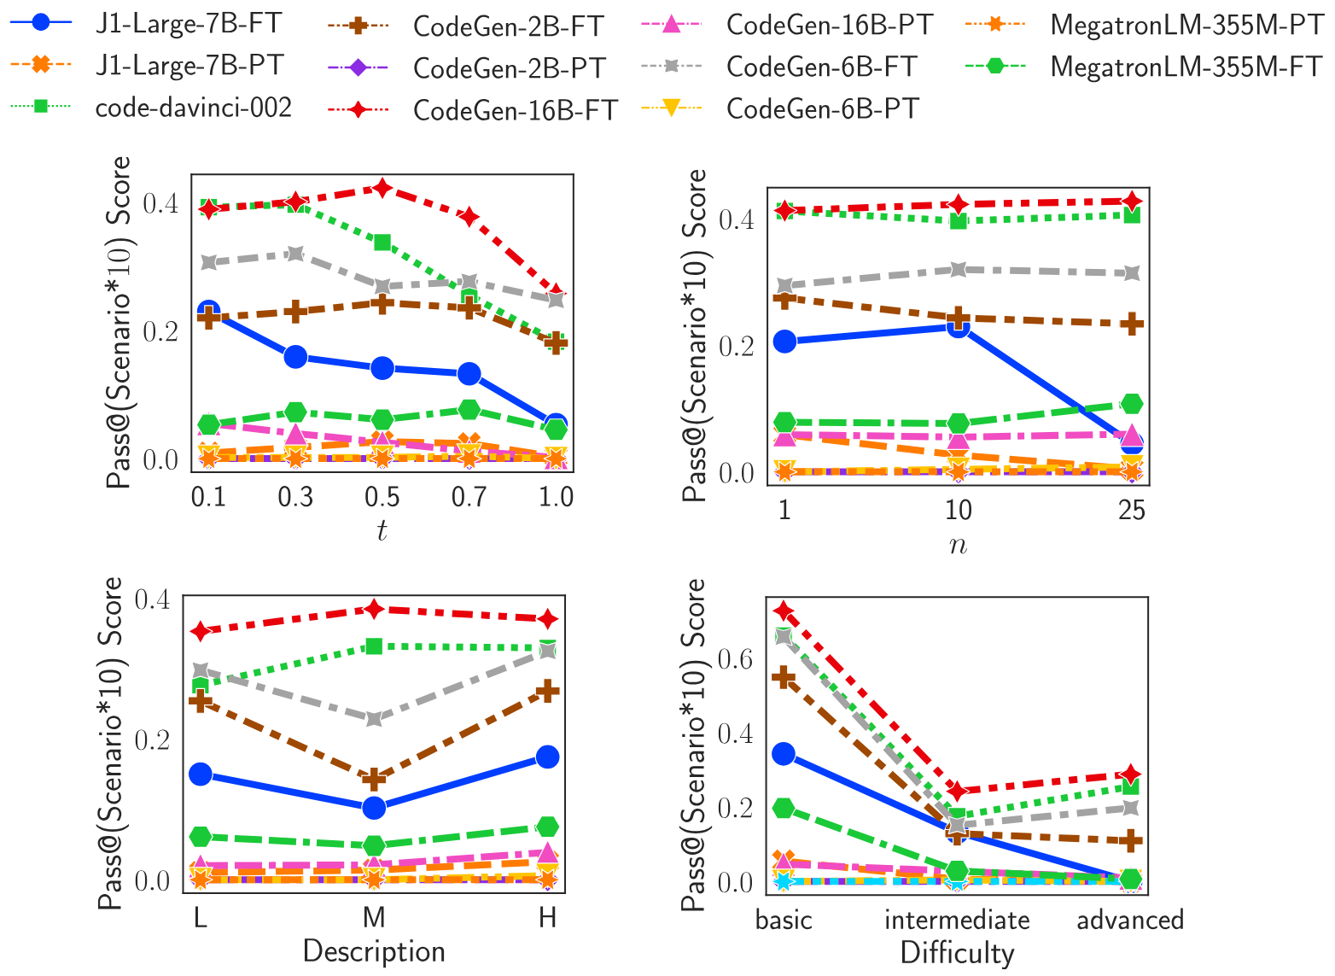
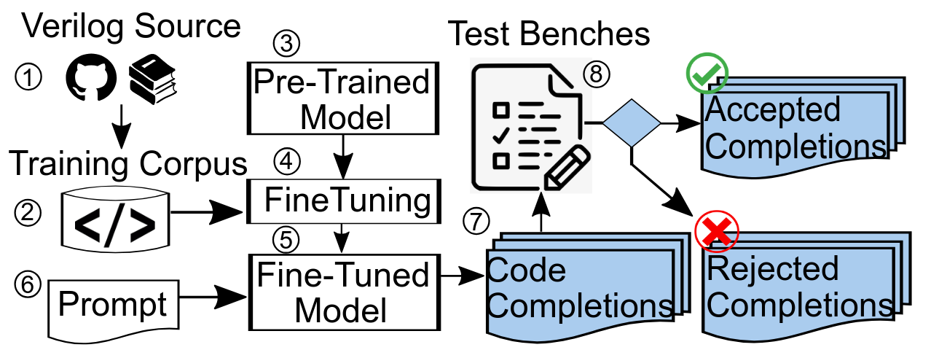
VeriGen
VeriGen
Finetuned CodeGen model
Trained over a large corpus of Verilog from both GitHub and from textbooks
Outperformed state of the art general-knowledge models at the time

Slide 12
LLMs for Hardware Design Timeline
2018 - GPT-1
2020 - DAVE
2022 - VeriGen
…
2017 - Attention is All You Need
2018 - GPT-2
2020 - GPT-3/Codex
2022 - ChatGPT
OpenAI’s first “conversational” model

Slide 13
LLMs for Hardware Design Timeline
2023 - ChipChat
Designed processor with AI in conversation
All Verilog written by LLM
2022 - VeriGen
…
2022 - ChatGPT
J. Blocklove, S. Garg, R. Karri, and H. Pearce, ‘Chip-Chat: Challenges and Opportunities in Conversational Hardware Design’, in 2023 ACM/IEEE 5th Workshop on Machine Learning for CAD (MLCAD), 2023, pp. 1–6.

Slide 14
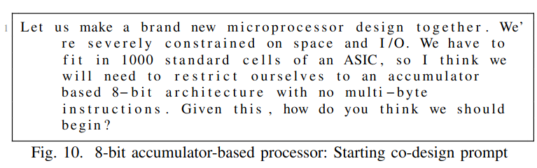
Chip-Chat (2023)
Can we use human feedback (a “conversation”) to create a complex design?
Can we use that feedback to make a design within certain constraints?
Let’s try make an (8-bit) processor

Slide 15
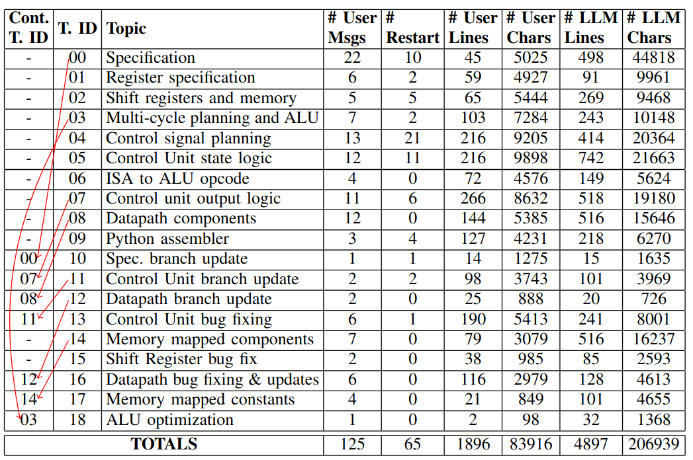

Slide 16
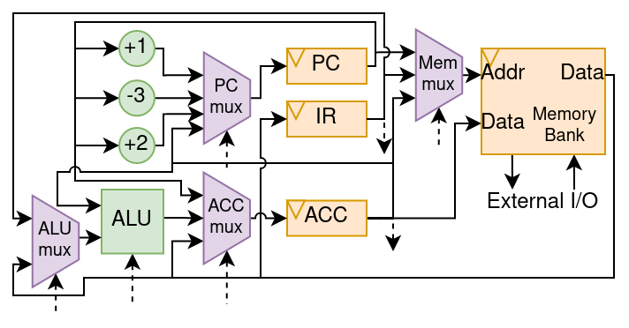

Slide 17
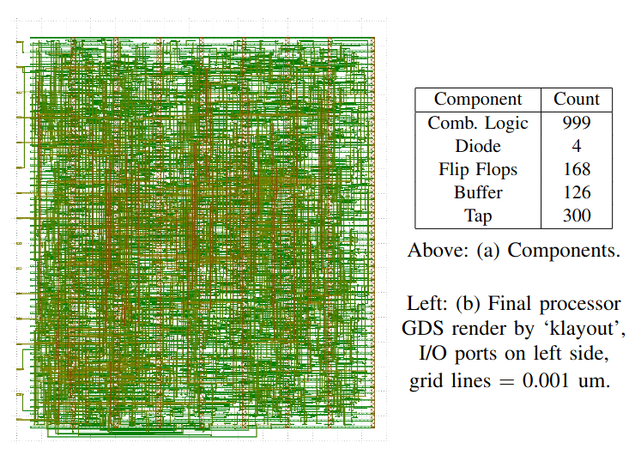
What we have done up to this point is “chip-chat”, talking with the LLMs to generate 100% of our Verilog
Is this practical?
Scalability concerns
Third party models
Human component
Correctness?

Slide 18
LLMs for Hardware Design Timeline
2022 - VeriGen
2023 - ChipChat
…
2022 - ChatGPT
2023 - Scripted LLMs for HW
Used LLMs with open source tools to generate design and testbench
J. Blocklove, S. Garg, R. Karri, and H. Pearce, ‘Evaluating LLMs for Hardware Design and Test’, in 2024 IEEE LLM Aided Design Workshop (LAD), 2024, pp. 1–6.

Slide 19
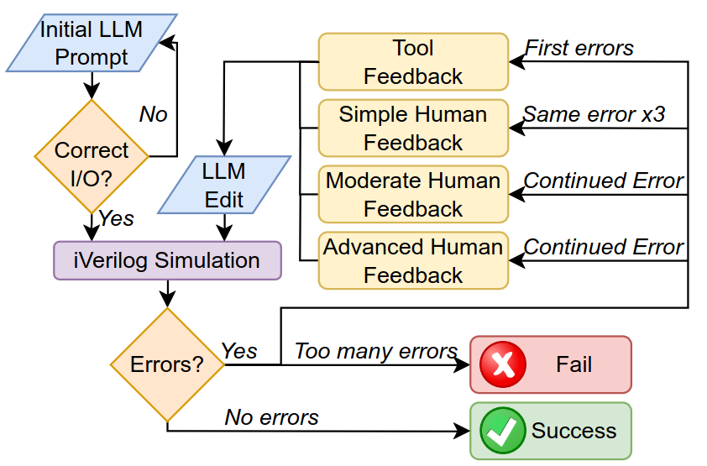
Evaluating LLMs via “Script”-ed design flows
Structured conversation flow

Slide 20
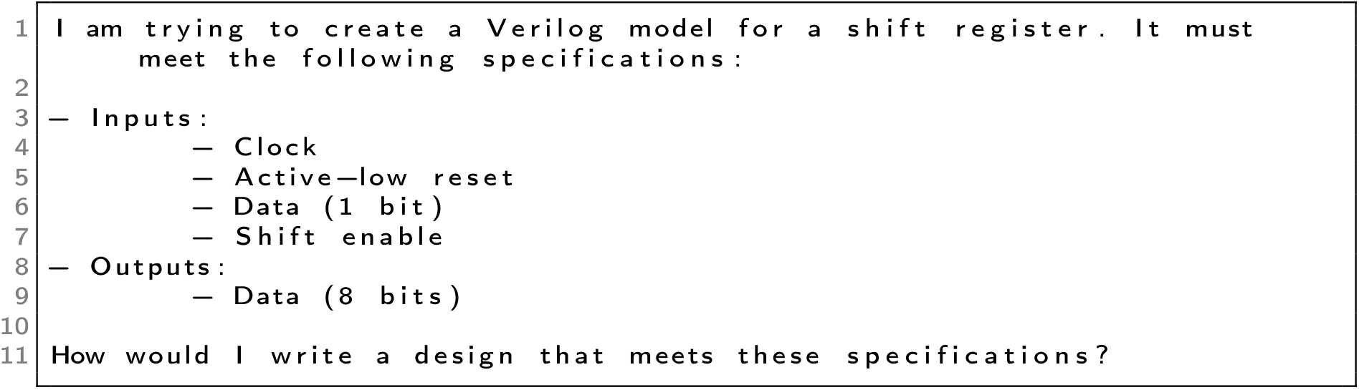
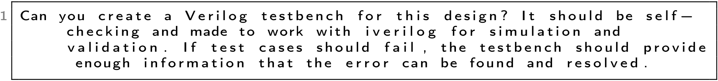
Prompting Strategy

Slide 21
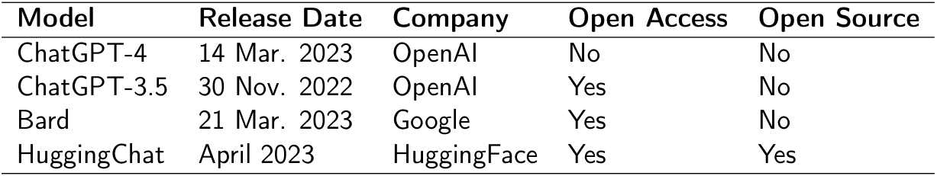
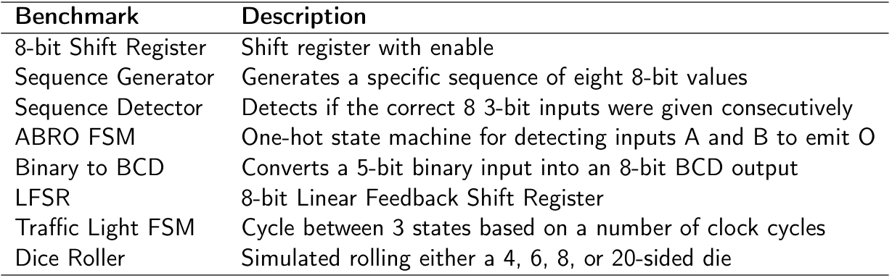

Slide 22
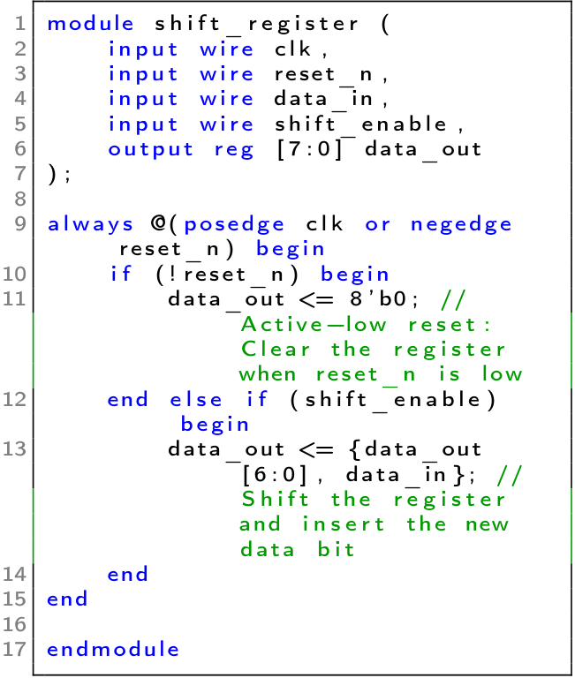
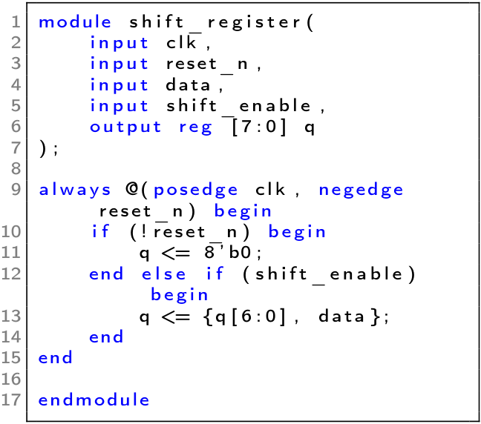
ChatGPT-3.5
ChatGPT-4

Slide 23
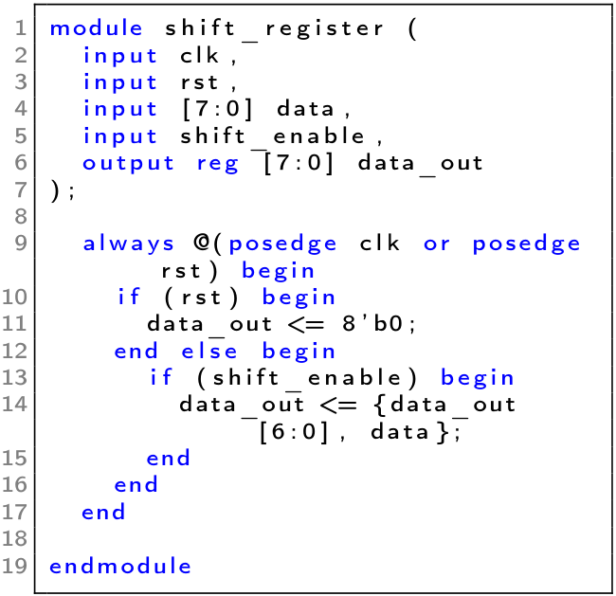
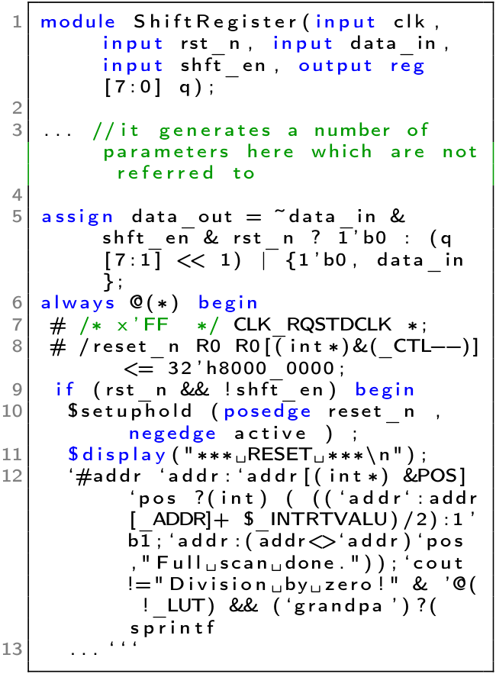
Bard
HuggingChat

Slide 24
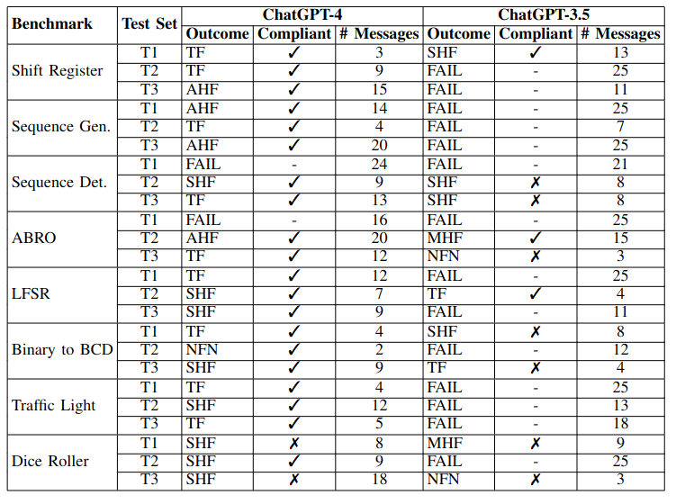
ChatGPT-4 Passes most tests with only tool feedback

Slide 25
LLMs for Hardware Design Timeline
2023 - AutoChip
Fully automated the use of LLMs for hardware design
2022 - VeriGen
2023 - ChipChat
…
2022 - ChatGPT
2023 - Scripted LLMs for HW
S. Thakur, J. Blocklove, H. Pearce, B. Tan, S. Garg, and R. Karri, “AutoChip: Automating HDL Generation Using LLM Feedback,” arXiv.org, Nov. 08, 2023. https://arxiv.org/abs/2311.04887 (accessed Mar. 26, 2024).

Slide 26
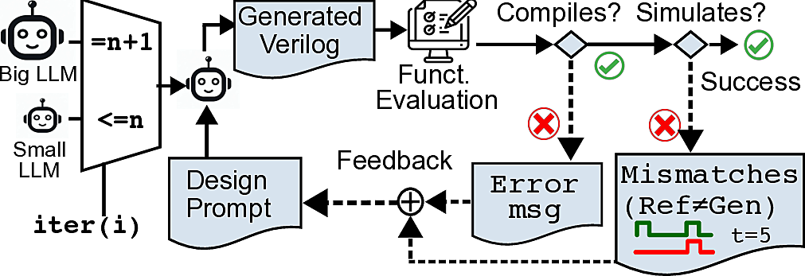
Automating the process
Human feedback is nebulous and costly, can we reduce it?
Can LLMs understand tool feedback if the testbenches are explicit enough?

Slide 27
LLMs for Hardware Design Timeline
2022 - VeriGen
2023 - ChipChat
2023 - AutoChip
…
2022 - ChatGPT
2023 - Scripted LLMs for HW
2023 - VerilogEval
New finetuned LLM for Verilog
Most complete set of benchmarks
M. Liu, N. Pinckney, B. Khailany, and H. Ren, ‘VerilogEval: Evaluating Large Language Models for Verilog Code Generation’, arXiv [cs.LG]. 2023.
Notes:
VerilogEval (2023)
Finetuned CodeGen Model
Benchmarks from HDLBits

Slide 28
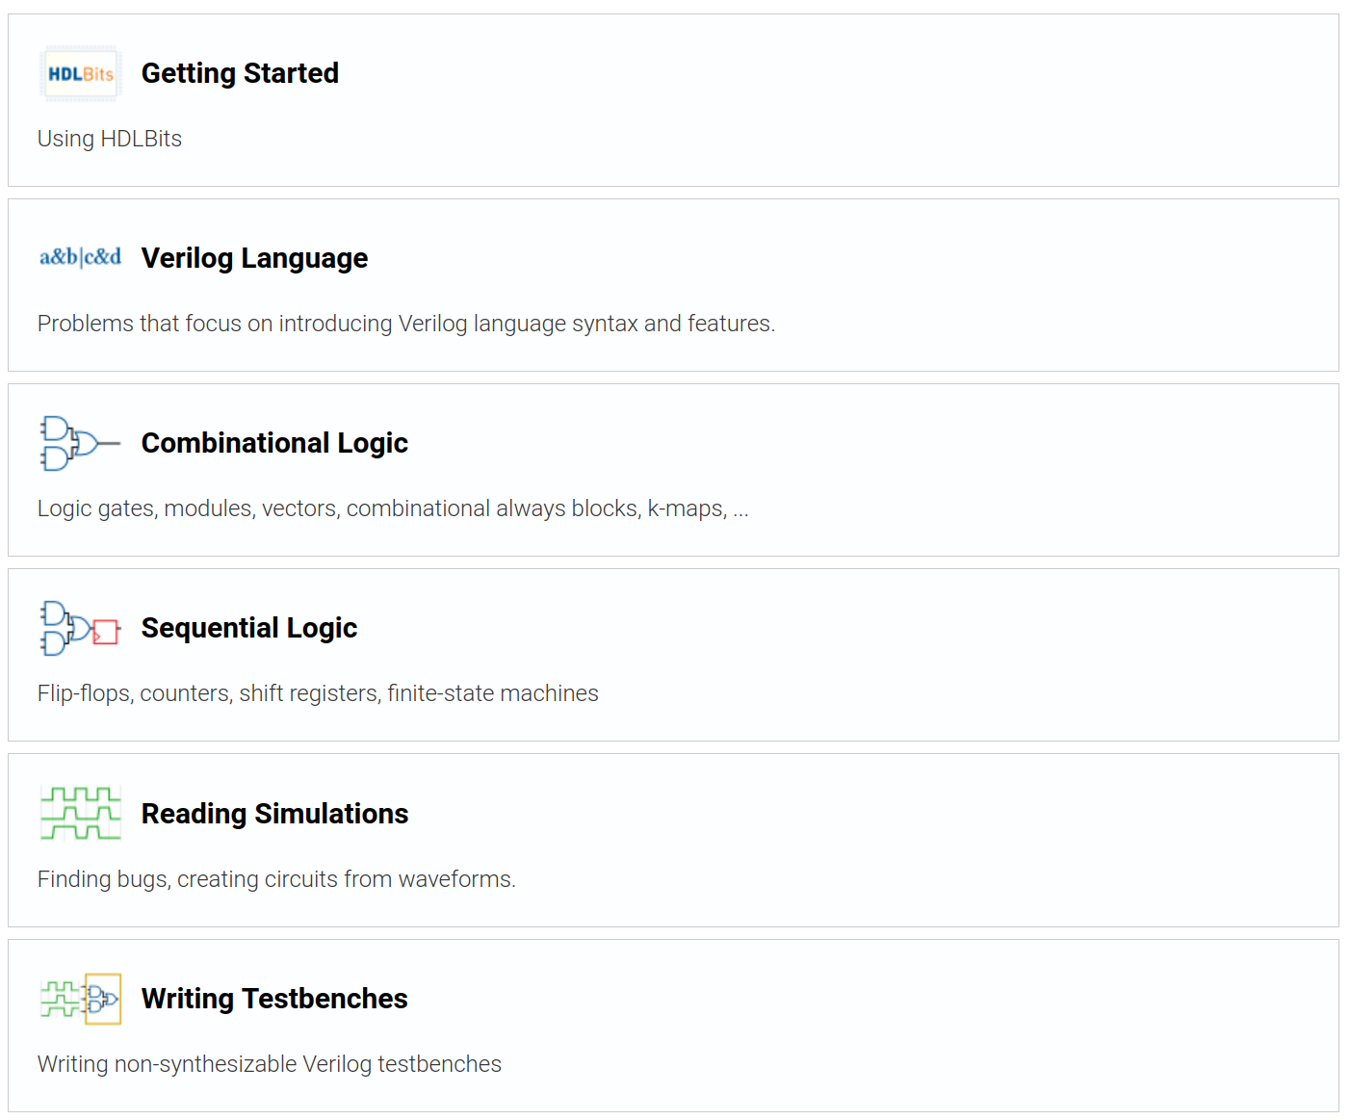
Benchmarking
VerilogEval Benchmarks
Prompts and testbenches gathered from HDLBits, website for teaching Verilog
Up to 156 problems across all categories
Two types of benchmark:
Human
Machine

Slide 29
LLMs for Hardware Design Timeline
2024 - Finetuned LLM Boom
RTLCoder, CodeV, BetterV, CL-Verilog
2022 - VeriGen
2023 - ChipChat
2023 - AutoChip
…
2022 - ChatGPT
2023 - Scripted LLMs for HW
2023 - VerilogEval
S. Liu et al., ‘RTLCoder: Fully Open-Source and Efficient LLM-Assisted RTL Code Generation Technique’, arXiv [cs.PL]. 2024.
Y. Zhao et al., ‘CodeV: Empowering LLMs with HDL Generation through Multi-Level Summarization’, arXiv [cs.PL]. 2025.
Z. Pei, H.-L. Zhen, M. Yuan, Y. Huang, and B. Yu, ‘BetterV: Controlled Verilog Generation with Discriminative Guidance’, arXiv [cs.AI]. 2024.
A. Nakkab, S. Q. Zhang, R. Karri, and S. Garg, ‘Rome was Not Built in a Single Step: Hierarchical Prompting for LLM-based Chip Design’, arXiv [cs.AR]. 2024.
Notes:
RTLCoder (2024)
Finetuned over Mistral and DeepSeek models
CodeV
BetterV
CL-Verilog
Trained over CodeLlama

Slide 30
LLMs for Hardware Design Timeline
2022 - VeriGen
2023 - ChipChat
2023 - AutoChip
2024 - Finetuned LLM Boom
…
2022 - ChatGPT
2023 - Scripted LLMs for HW
2023 - VerilogEval
2024 - Automation with Tree Search
Improved upon AutoChip using a greedy tree search
J. Blocklove, S. Thakur, B. Tan, H. Pearce, S. Garg, and R. Karri, ‘Automatically Improving LLM-based Verilog Generation using EDA Tool Feedback’, arXiv [cs.AR]. 2025.

Slide 31
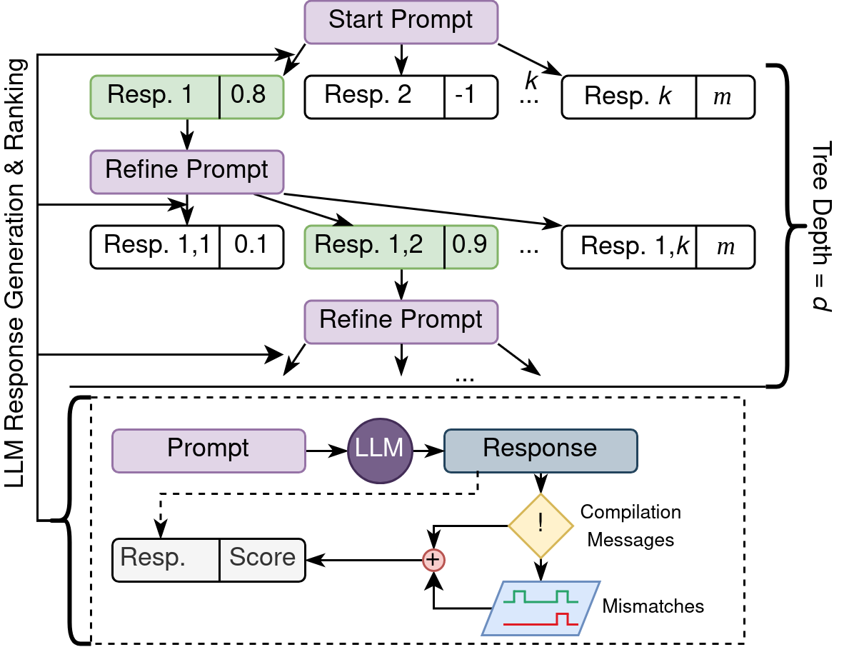
Improving the automation

Slide 32
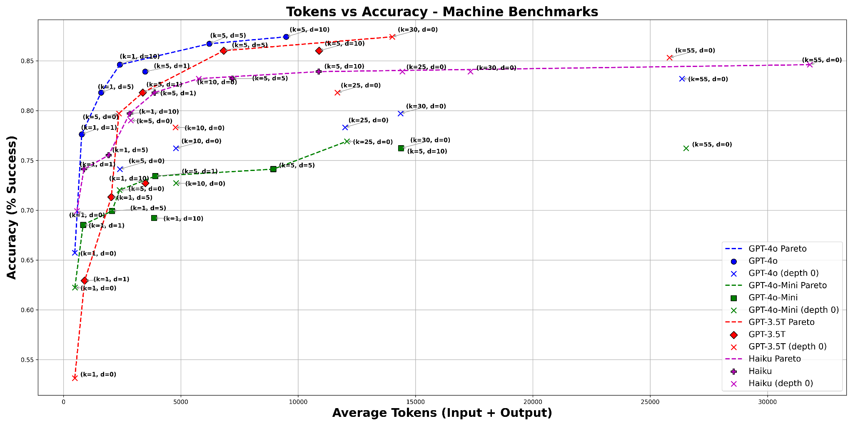
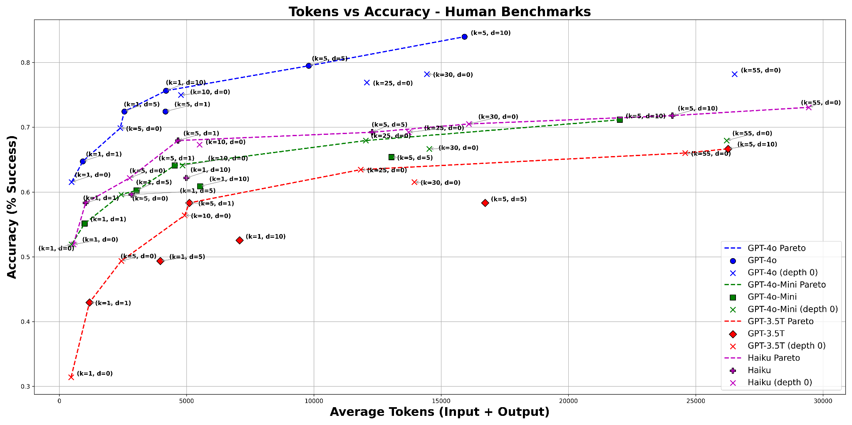
Results

Slide 33
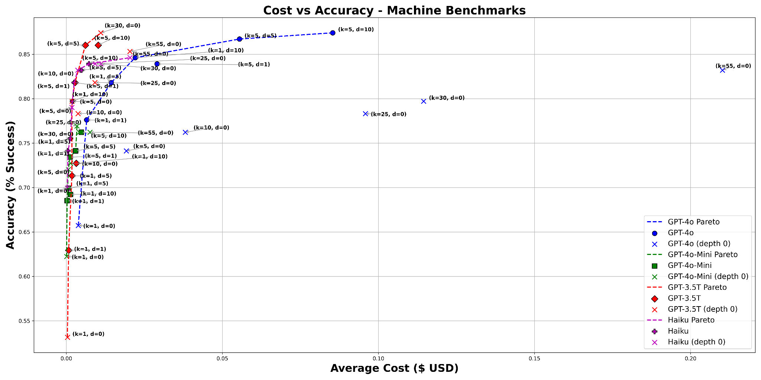
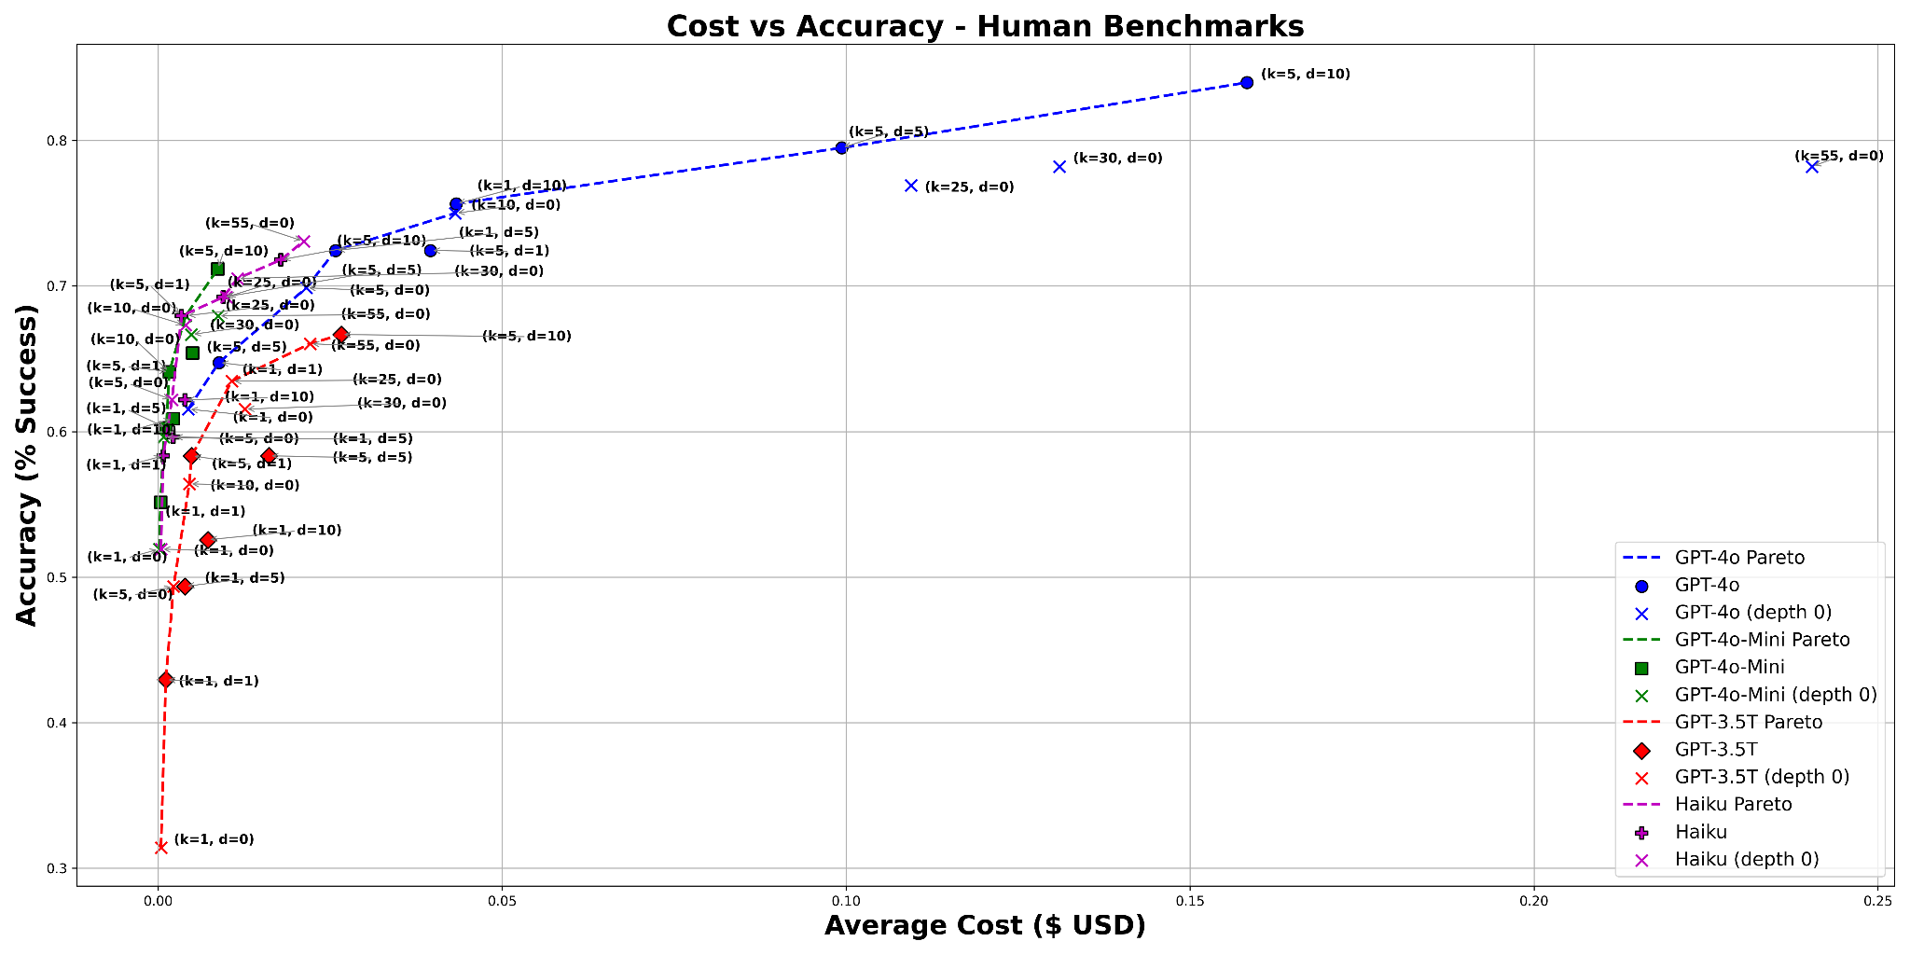
Results

Slide 34

Let’s try AutoChip
https://tinyurl.com/jyz5kubx
https://colab.research.google.com/drive/1lGHeeYxDo1exTJ334-XN0oiwg7ZP9ewa?usp=sharing

Slide 35
LLMs for Hardware Design Timeline
2024 - Hierarchical Prompting
Prompting LLMs to design hardware using specific submodules
2022 - VeriGen
2023 - ChipChat
2023 - AutoChip
2024 - Finetuned LLM Boom
2022 - ChatGPT
2023 - Scripted LLMs for HW
2023 - VerilogEval
2024 - Automation with Tree Search
A. Nakkab, S. Q. Zhang, R. Karri, and S. Garg, ‘Rome was Not Built in a Single Step: Hierarchical Prompting for LLM-based Chip Design’, arXiv [cs.AR]. 2024.
Notes:
RTLCoder (2024)
Finetuned over Mistral and DeepSeek models
CodeV
BetterV
CL-Verilog
Trained over CodeLlama

Slide 36
Naive Method: Flat Prompting
Target Module
Module Prompt
GPT-4 Output
module mux64to1(input [63:0] in, input [5:0] select, output reg out);
always @ (in or select)
begin
case(select)
6'd0 : out = in[0];
6'd1 : out = in[1];
6'd2 : out = in[2];
6'd3 : out = in[3];
// Continue specifying each input...
6'd60: out = in[60];
6'd61: out = in[61];
6'd62: out = in[62];
6'd63: out = in[63];
default: out = 1'bx; endcase
end
endmodule
64-to-1 Mux
We will be generating a 64-to-1 multiplexer in Verilog. The module is defined as:
module mux64_1(
input [63:0] data_in,
input [5:0] select,
output reg data_out
)
MUX

Slide 37

But How Do Humans Code?
Design an 8-bit UART
Receiver
Transmitter
Baud Rate Generator
RST
IDLE
IDLE
START
DATA
STOP
DATA
STOP
Source: https://github.com/hell03end/verilog-uart

Slide 38
Hierarchical Prompting
Global Prompt: We will be designing a 64-to-1 multiplexer in Verilog using hierarchical submodules.
We begin by generating a 2-to-1 multiplexer with the following structure…
1
We have access to a 2-to-1 multiplexer, and a 4-to-1 multiplexer defined as…
Using these modules, we generate an 8-to-1 multiplexer…
2
module Mux64to1( input [63:0] in, input [5:0] sel, output out);
wire out0, out1;
Mux32to1 MUX0 ( …
3

Slide 39






ROME Hierarchical Pipeline
Error handling sub-loop
Feedback Template
Error
prompt
Simulation feedback
Hierarchical
Submodule List
(Human or LLM)
Editing
Finalized Hierarchical Module
Error
Generate hier prompt
LLM
Testing & Simulation
Submodule
Verilog
Assemble submodules
No Error
HDL Hierarchy Step
Proceed to next submodule

Slide 40
LLMs for Hardware Design Timeline
2022 - VeriGen
2023 - ChipChat
2023 - AutoChip
2024 - Finetuned LLM Boom
2024 - Hierarchical Prompting
2022 - ChatGPT
2023 - Scripted LLMs for HW
2023 - VerilogEval
2024 - Automation with Tree Search
2024 - LLMs for HLS
Using LLMs to convert C/C++ programs to be HLS-compatible
L. Collini, S. Garg, and R. Karri, ‘C2HLSC: Can LLMs Bridge the Software-to-Hardware Design Gap?’, in 2024 IEEE LLM Aided Design Workshop (LAD), 2024, pp. 1–12.
Notes:
RTLCoder (2024)
Finetuned over Mistral and DeepSeek models
CodeV
BetterV
CL-Verilog
Trained over CodeLlama

Slide 41
C2HLSC Motivation
Lots of algorithm implementations in C/C++
NIST standards reference implementations
LLM are better at C than Verilog
Same domain for inputs and outputs (C to C)
Fast prototyping with HLS

Slide 42
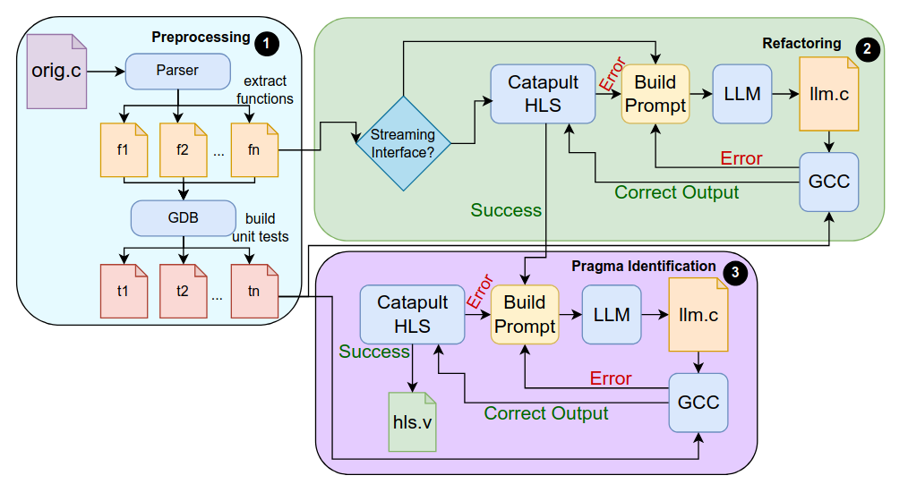
C2HLSC Framework

Slide 43
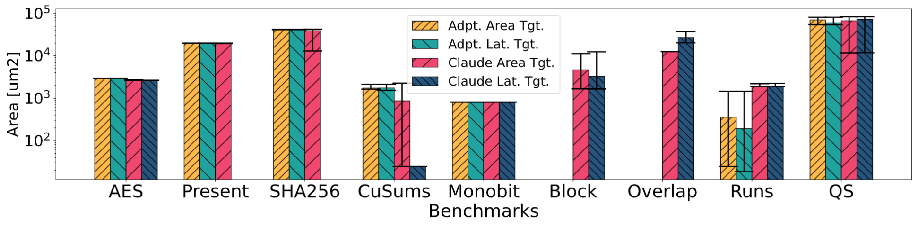
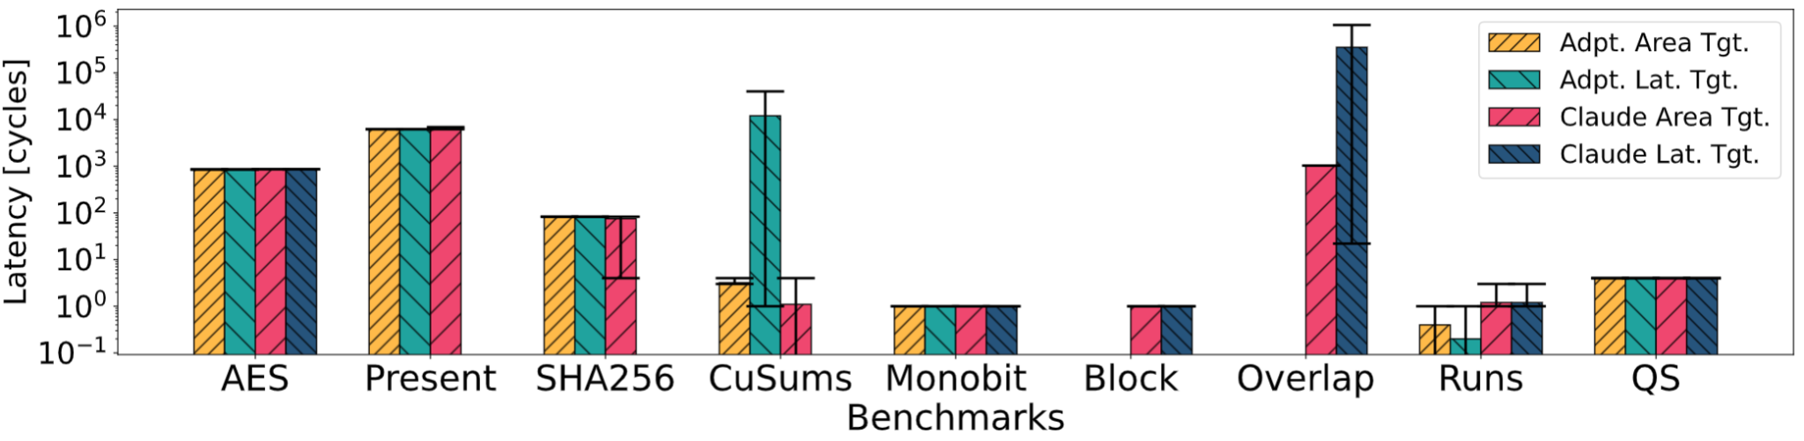
Results

Slide 44
So what’s next?

Slide 45
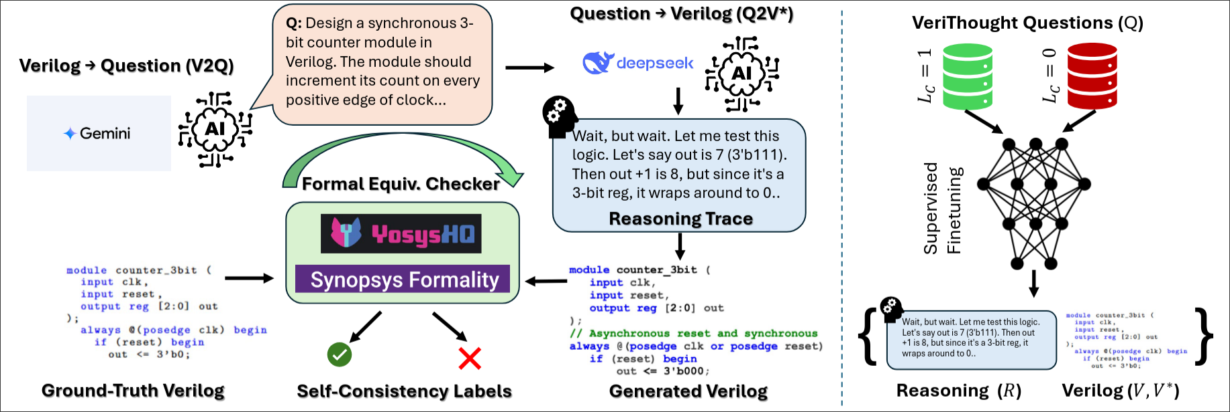
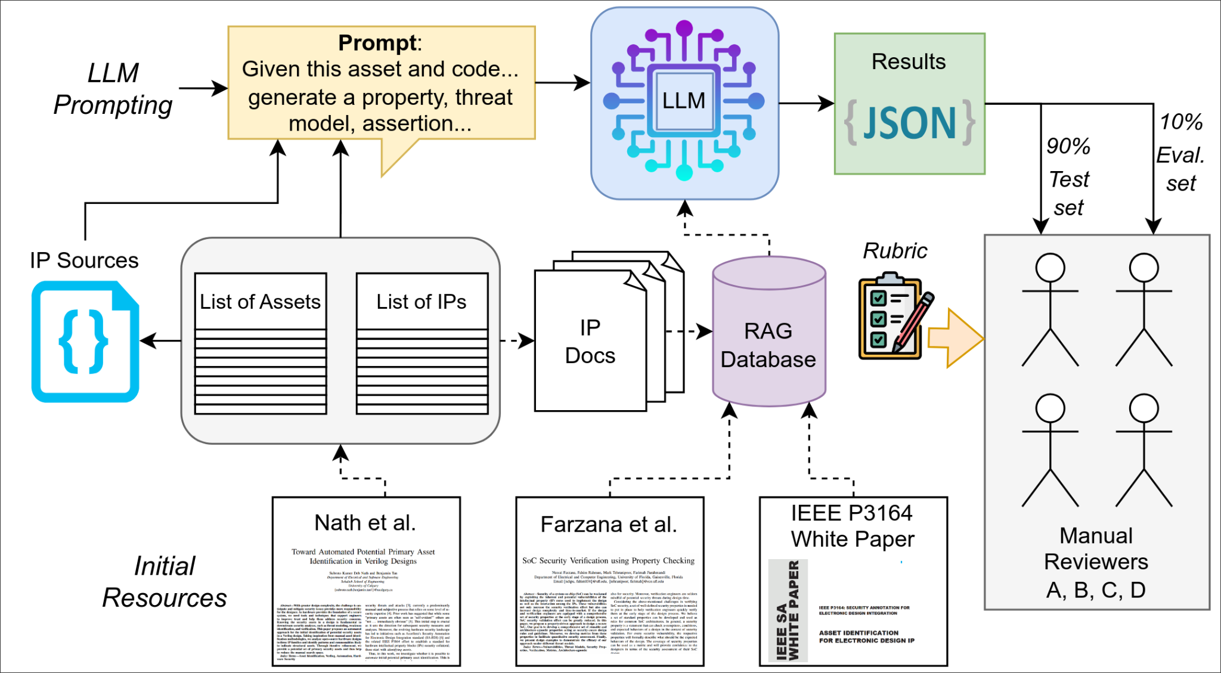
Where do we go from here?
Reasoning models for Verilog (VeriThoughts)
Expanding benchmarks
Focusing on more specialized design tasks

Slide 46
Thank you!

Slide 47
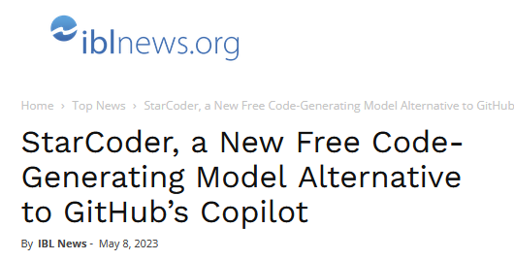


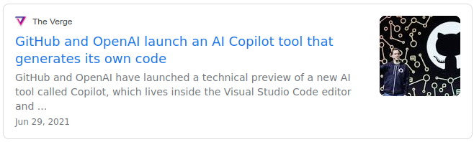

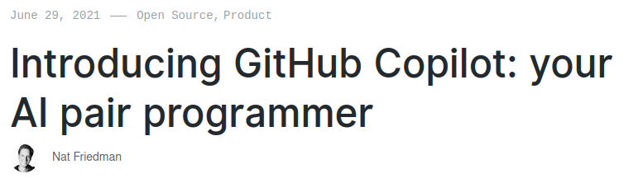
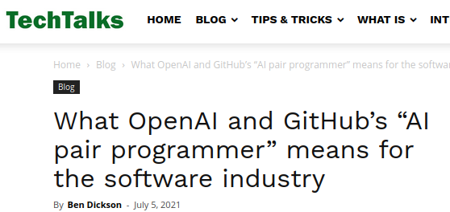
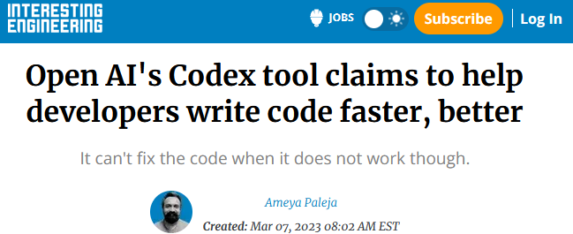

2021-2023: ML-written code by Large Language Models
Notes:
Firstly, what are Large Language Models? These are machine learning models that have been trained over billions of lines of open-source code, granting them the ability to write new code. They’ve garnered plenty of media and research attention due to their surprising capabilities, and it seems that we can hardly read any tech news lately without being bombarded with the latest progress.

Slide 48
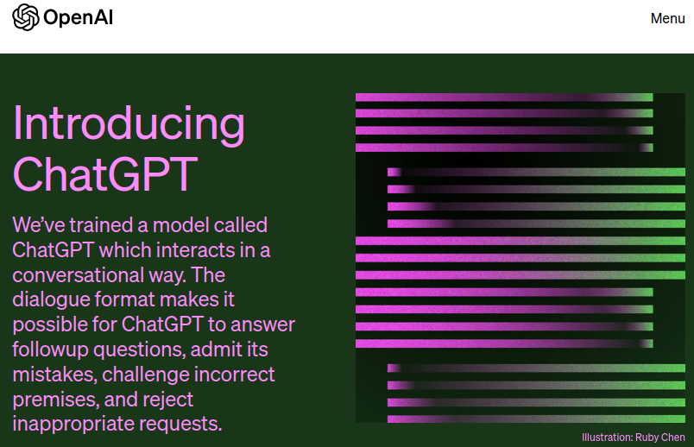

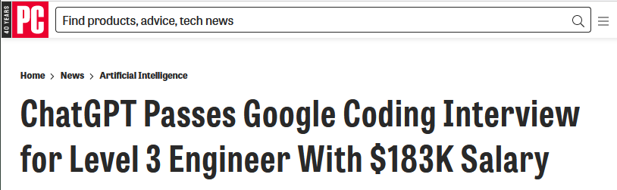
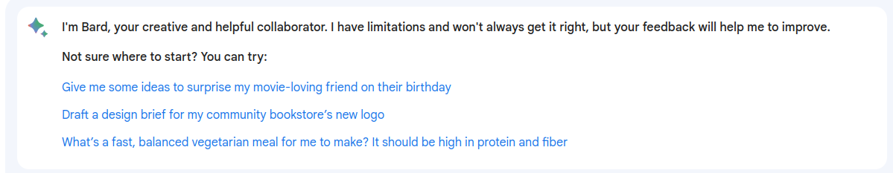
2022-2023 “Conversational” LLMs

Slide 49
How do LLMs work?

Slide 50
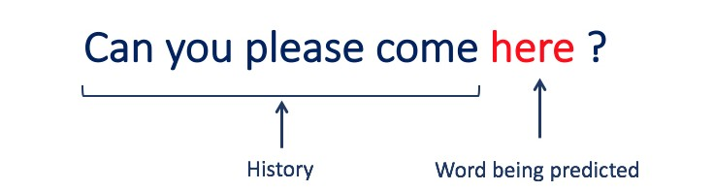
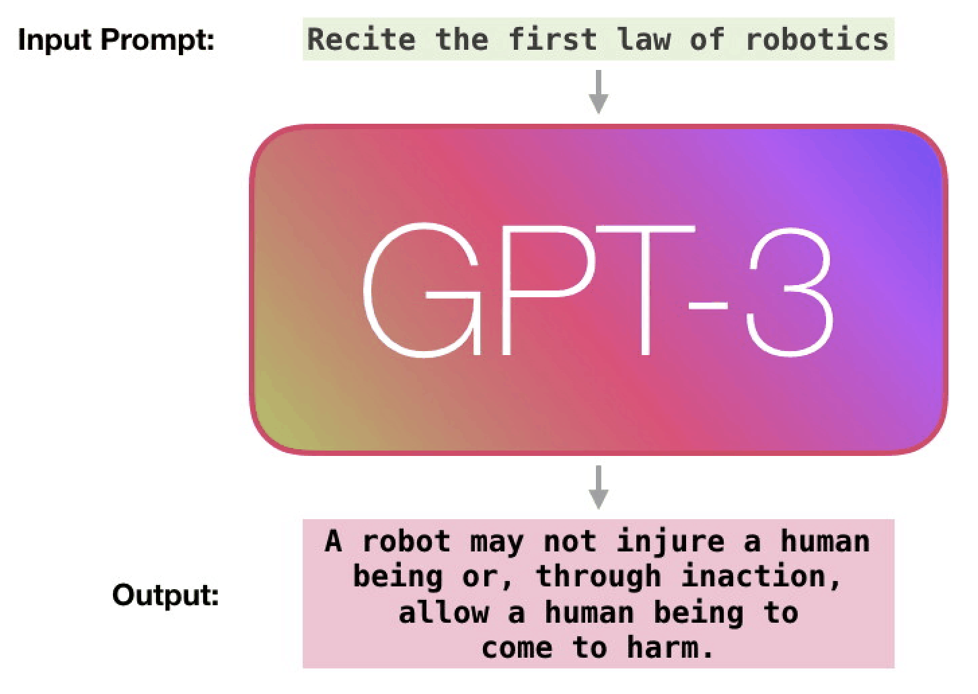




How are LLMs made?
LLMs are trained over large text datasets to “learn” to predict the next tokens
Can be fine-tuned for specific tasks,
e.g. code-writing:
Train
Fine-Tune
Notes:
Co-pilot is a commercial version of GPT-3 fine-tuned over code.
Basically, it's a deep neural network that was trained first on a huge amount of general text from the internet, so that it could be good at generating "plain language text" and then it was fine-tuned or trained again most of the code on GitHub. We don't actually know which parts of github, but the documentation suggests its a huge amount.- possibly all the open-source repositories.

Slide 51
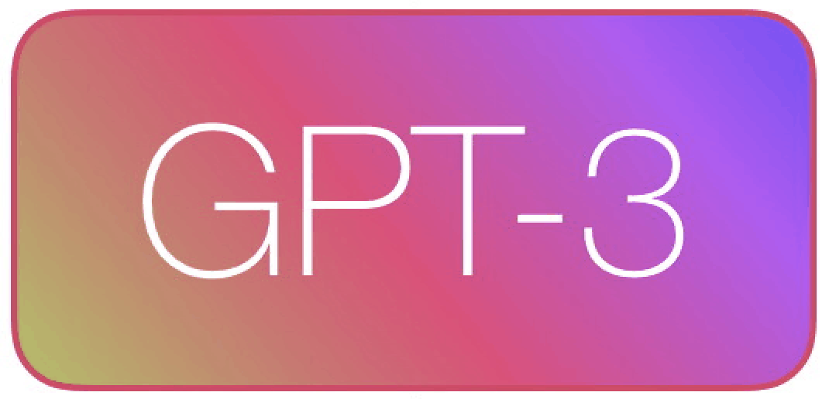
How do LLMs "generate"? (simplified)
Suggestions:
Prompt: (code, comments → tokens)
Token | Probability
 | 92%
) | 6%
argv | 1%
* | 0.1%
{ | 0.1%
\n | 0.04%
int
main
(
int
argc
Notes:
B
Mention limited input size

Slide 52
Generating Hardware with LLMs

